Slide 1
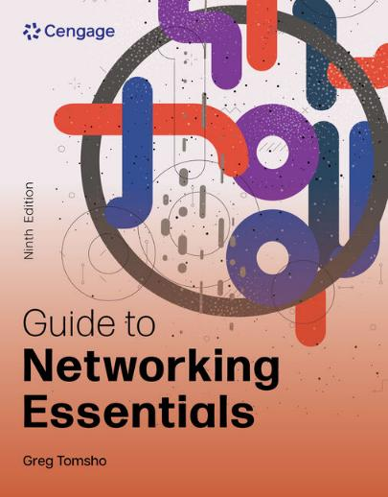
Guide to Networking Essentials, 9e
Chapter 12: Network Management and Administration
.

Slide 2
Chapter Objectives
By the end of this chapter, you should be able to:
Manage user and group accounts
Administer permissions on storage volumes
Work with shared files and printers
Monitor a system’s performance and reliability
Describe fault-tolerance and backup solutions

Slide 3
Managing User and Group Accounts
User accounts have two main functions:
Provide a method for users to authenticate themselves to the network
Provide detailed information about a user
Group accounts are used to organize users so that assignment of resource permissions and rights can be managed more easily than working with dozens or hundreds of individual user accounts

Slide 4
Account and Password Conventions (1 of 2)
In a large network, a scheme for naming user and group accounts as well as network devices is crucial. Consider the following:
Is there a minimum and maximum number of characters user account names should have?
Should the username be based on the user’s real name, or, if security is important, should names be more cryptic?
Some OSs distinguish between uppercase and lowercase letters. Should usernames contain both as well as special characters?

Slide 5
Account and Password Conventions (2 of 2)
Considerations for password naming conventions include the following:
Minimum length
Complexity requirements—use of uppercase and lowercase along with numbers and special characters
User or administrator created
Password change frequency
Group account names should reflect the group membership or the resource to which the group is assigned permissions
Once naming conventions have been established, stick to them

Slide 6
Working with Accounts in Windows (1 of 8)
When Windows is first installed, two users are created: Administrator and Guest
On a Windows Server the Guest account is disabled and in Windows clients both Administrator and Guest are disabled
You create a user with administrator privileges during installation
The Administrator account has full access to a computer
In a Windows domain, the domain Administrator account’s access is extended to all computers that are domain members

Slide 7
Working with Accounts in Windows (2 of 8)
Creating User Accounts in Windows Domains
Windows domain users are created in Active Directory Users and Computers, in Active Directory Administrative Center (ADAC), or with command-line tools
You can create folders for organizing users and groups (called organization units or OUs)
Follow the steps outlined in the text to create a user

Slide 8
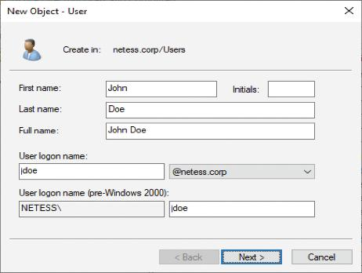
Working with Accounts in Windows (3 of 8)
Figure 12-2 Creating a user in Active Directory

Slide 9
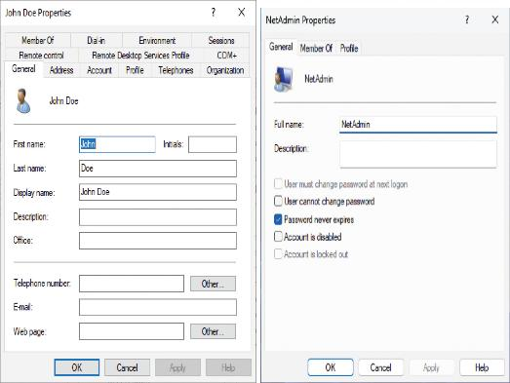
Working with Accounts in Windows (4 of 8)
Figure 12-4 User properties in Active Directory (left) and in Windows 11 (right)

Slide 10
Working with Accounts in Windows (5 of 8)
Creating Group Accounts in Windows Domains
Group accounts only require a name in order to be created
After they are created you can begin adding users as members
Group scope has three options: Domain local, Global, and Universal
Group type has two options:
Security (default)
Distribution

Slide 11
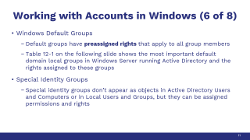
Working with Accounts in Windows (6 of 8)
Windows Default Groups
Default groups have preassigned rights that apply to all group members
Table 12-1 on the following slide shows the most important default domain local groups in Windows Server running Active Directory and the rights assigned to these groups
Special Identity Groups
Special identity groups don’t appear as objects in Active Directory Users and Computers or in Local Users and Groups, but they can be assigned permissions and rights

Slide 12
Working with Accounts in Windows (7 of 8)
Table 12-1 Some Windows Server default domain local groups
Group | Rights
Administrators | Has complete control over the computer and domain
Account Operators | Can administer user and group accounts for the local domain
Backup Operators | Can back up and restore files that users normally can’t access
Guests | Is allowed guest access to domain resources; same access as the Users group
Print Operators | Can add, delete, and manage domain printers
Server Operators | Can administer domain servers
Users | Has default access rights that ordinary user accounts have

Slide 13
Working with Accounts in Windows (8 of 8)
A user profile is a collection of user’s personal files and settings that define their working environment
A user profile stored on the same system where the user logs on is called a local profile
When logging off, profile settings are saved in their local profiles so that all their settings are preserved
If administrators want to make users’ profiles available on any computer they log on to, they can set up roaming profiles
Mandatory profiles discard a user’s profile changes at log off so the profile is always the same
youtube.com/watch?v=OfXJlmuoc20

Slide 14
Working with Accounts in Linux (1 of 3)
User and group accounts in Linux are used for the same purpose as Windows: user authentication and authorization
Linux OSs also have a default user who has full control over the system—named “root”
Most Linux administration takes place at the command line
useradd newuser (replace newuser with the logon name for the user account you’re creating) command creates a new user
You will then create a password for the user with the passwd newuser command

Slide 15
Working with Accounts in Linux (2 of 3)
All users must belong to at least one group in Linux
When a new user is created, a new group with the same name is also created and the user is made a member
Use the groupadd command to create groups
To add users to a group:
useradd username groupname
Many administrators prefer the command-line method for creating users because they can import user information from a text file

Slide 16
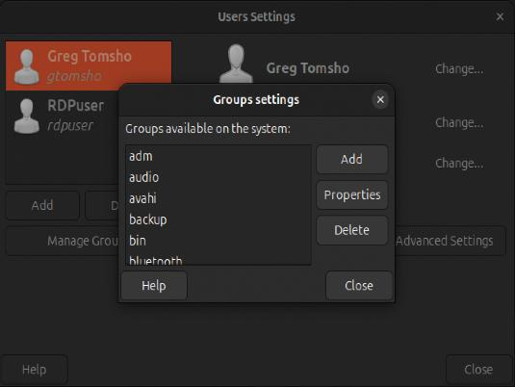
Working with Accounts in Linux (3 of 3)
Figure 12-8 The Users and Groups app in Ubuntu Linux

Slide 17
Storage and File Management
Network administrators need to:
Make sure enough storage space is available to store files needed
Manage who has access to file storage
Prevent users from storing inappropriate types of data on company servers
Locally attached storage is a device, such as a hard disk, that is connected to a storage controller on the server

Slide 18
Volumes and Partitions (1 of 2)
A volume is part or all of the space on one or more disks that contains (or is ready to contain) a file system
In Windows, volumes with file systems are assigned a drive letter
In Linux, volumes are accessed as though they were a folder
In Windows, a basic disk can be divided into one to four partitions
A primary partition can be formatted with a file system and assigned a drive letter (considered a volume)
An extended partition is divided into one or more logical drives that can be formatted and assigned a drive letter (considered a volume)

Slide 19
Volumes and Partitions (2 of 2)
Only a primary partition can be the active partition
The active primary partition storing the Windows boot loader is referred to as the system partition
The partition or logical drive holding the Windows OS files is called the boot partition
A dynamic disk can be divided into one or more volumes
Linux systems refer to disks by using their device driver name plus a letter, starting with “a”
Example: /dev/sda, followed by /dev/sdb, and so on

Slide 20
The FAT File System
The File Allocation Table (FAT) file system has two variations:
FAT16 is usually referred to as FAT and has been around since the mid-1980s and is limited to 2 GB partitions
FAT32, released with Windows 95 OSR2 in 1996, allows partitions up to 2 TB but in Windows 2000 and later, Microsoft limits them to 32 GB
FAT doesn’t support file and folder permissions for users and groups
FAT also lacks support for encryption, file compressions, disk quotas, and reliability features

Slide 21
The NTFS File System (1 of 7)
NTFS is a file system Microsoft introduced with Windows NT
Features available in NTFS that aren’t in FAT:
Disk quotas—limit amount of data users’ files can occupy
Volume mount points—no need for a drive letter to access
Shadow copies—allows users to restore older file versions or files that were accidentally deleted
File compression—files can be compressed
Encrypting File System—makes encrypted files inaccessible to everyone except the user who encrypted the file

Slide 22
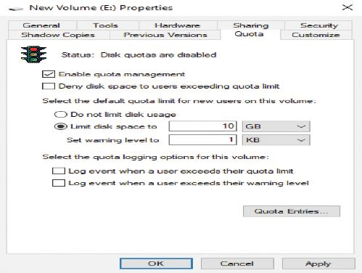
The NTFS File System (2 of 7)
Figure 12-12 The Quota tab

Slide 23
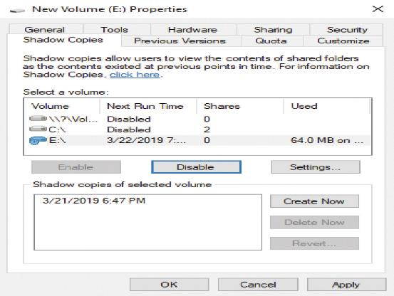
The NTFS File System (3 of 7)
Figure 12-13 The Shadow Copies tab

Slide 24
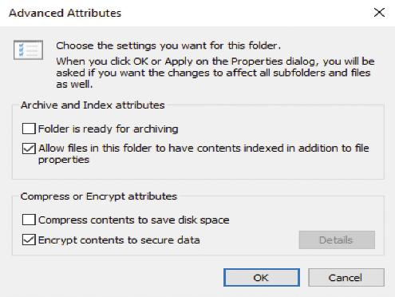
The NTFS File System (4 of 7)
Figure 12-14 The Advanced Attributes dialog box
File compression and encryption on an NTFS volume are implemented as file attributes.

Slide 25
The NTFS File System (5 of 7)
Share permissions are applied when a user attempts network access to shared files
NTFS permissions always apply, whether file access is attempted interactively or remotely through a share
Permissions can be viewed as a gatekeeper to control who has access to folder and files
Principle of Least Privilege (PoLP) refers to giving users the least access necessary for their jobs

Slide 26
The NTFS File System (6 of 7)
NTFS permissions can be configured on folders and files
By default, when permissions are configured on a folder, subfolders and files in that folder inherit the permissions but can be changed by the admin
To view or edit permissions on an NTFS folder, access the Security tab of the Properties dialog box

Slide 27
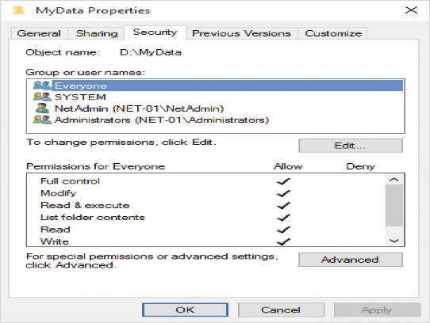
The NTFS File System (7 of 7)
Figure 12-15 NTFS Permissions

Slide 28
The Resilient File System (ReFS)
The Resilient File System (ReFS) is a specialized file system for large volumes available on Windows Server and select Windows 11 editions
ReFS works with Storage Spaces to automatically repair disk failure caused by corruption
It is the disk format of choice for storing virtual hard disks
Checkpoint merging is a process that consolidates changes in an NTFS file system’s transaction log
A checkpoint is a snapshot of the transaction log that ensures that the file system can recover from a sudden disruption

Slide 29
The Linux File System (1 of 2)
Linux supports many files systems
Ext3 and Ext4 are the default file system for most Linux distributions
There are only three permissions: read, write, and execute
There are three user types that can be assigned one or more permissions:
owner—owner of the file or folder
group—the primary group to which the owner belongs
other—all other users

Slide 30
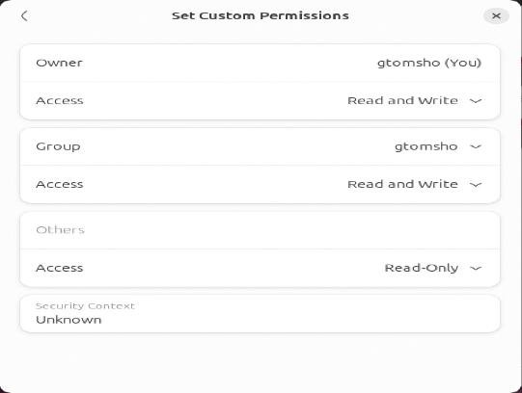
The Linux File System (2 of 2)
Figure 12-16 File permissions in the Linux GUI
youtube.com/watch?v=aqFfHKpRF7k

Slide 31
Knowledge Check Activity 12-1
Which feature of NTFS makes it possible to associate the root of a disk volume with a folder on an NTFS volume?
a. Shadow copies
b. Volume mount points
c. Dynamic disks
d. Journaling

Slide 32
Knowledge Check Activity 12-1: Answer
Which feature of NTFS makes it possible to associate the root of a disk volume with a folder on an NTFS volume?
Answer: b. Volume mount points
Explanation: Volume mount points make it possible to associate the root of a disk volume with a folder on an NTFS volume, thereby forgoing the need for a drive letter to access the volume.

Slide 33
Working with Shared Files and Printers
The dominant file-sharing protocol is Server Message Block (SMB)
SMB is the native Windows file-sharing protocol but is supported by Linux and MAC OS
Network File System (NFS) is the native Linux file-sharing protocol, and Windows can support NFS with the right software installed
Printer sharing also uses SMB on Windows and Linux
The native Linux printer-sharing protocol is Common UNIX Printing System (CUPS)

Slide 34
Sharing Files and Printers in Windows (1 of 4)
Part 2
Windows uses share and NTFS permissions
Share permissions are somewhat simpler than NTFS permissions with only 3 options: Read, Change, and Full Control
Methods to use when configuring shares:
Network access wizard
Advanced Sharing dialog box
Shared Folder snap-in
File and Storage Services

Slide 35
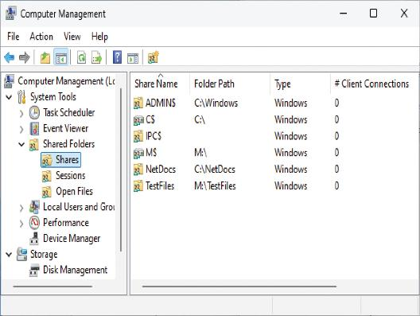
Sharing Files and Printers in Windows (2 of 4)
Figure 12-23 The Shared Folders snap-in

Slide 36
Sharing Files and Printers in Windows (3 of 4)
Components of a shared printer:
Print device—Two basic types of print device:
Local print device: Connected to an I/O port on a computer
Network print device: A printer attached to and shared by another computer
Printer—The icon in the Printers folder that represents print devices
Print server—A Windows computer sharing a printer
Print queue—Storage for print jobs awaiting printing

Slide 37
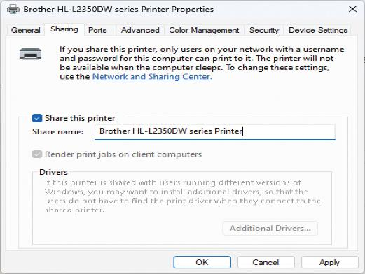
Sharing Files and Printers in Windows (4 of 4)
Figure 12-24 The Sharing tab for a print server

Slide 38
Sharing Files and Printers in Linux
Linux supports a number of options for sharing files and printers:
Samba
WebDav
Network File System (NFS)
Common UNIX Printing System (CUPS)

Slide 39
Monitoring System Reliability and Performance
Windows Server includes the following tools to manage and monitor server operation and resources:
Task Manager
Event Viewer
Performance Monitor
You have already used Task Manager, so this section focuses on the other two
youtube.com/watch?v=K-oHcDYmhUs File-Print Server

Slide 40
Event Viewer (1 of 2)
Event Viewer allows administrators to view event log entries, categorized by these levels:
Information—indicates normal operations, such as service stops and starts
Warning—information about events that should be brought to the administrator’s attention
Error—often generated when a process or service is unable to perform a task or stops unexpectedly
Critical—critical events are generated when the Windows OS experiences an error that causes the system to stop functioning

Slide 41
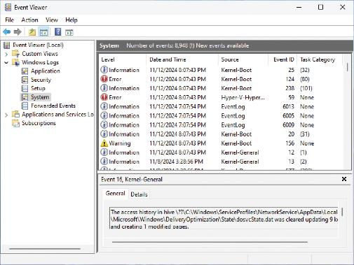
Event Viewer (2 of 2)
Figure 12-25 Event Viewer is Windows 11

Slide 42
Performance Monitor (1 of 2)
Performance Monitor is a collection of tools for pinpointing which resources are being overloaded and how they’re being overloaded
It contains the following folders:
Monitoring Tools—contains the Performance Monitor tool
Data Collector Sets—contains templates with sets of data points
Reports—contains performance and diagnostic reports
Performance Monitor uses counters to track the performance of a variety of objects
A counter is a value representing some aspect of an object’s performance

Slide 43
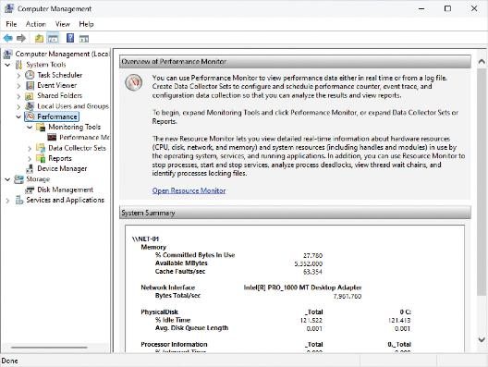
Performance Monitor (2 of 2)
Figure 12-26 The Performance Monitor tool

Slide 44
Enhancing Network Performance
Factors that can cause poor performance:
Poor or inadequate network design
Poor network traffic management
Network errors
Denial-of-service attacks

Slide 45
Network Performance Monitoring (1 of 2)
Two network protocols designed to monitor network performance:
Simple Network Management Protocol (SNMP)
Remote Monitoring (RMON)
Simple Network Management Protocol
To use SNMP, SNMP software agents are loaded on network devices you want to manage and monitor
Agents monitor network traffic and device status and stores information in a management information base (MIB)
A management station communicates with software agents and collects data stored in the MIBs

Slide 46
Network Performance Monitoring (2 of 2)
Remote Monitoring (RMON) is an advanced network-monitoring protocol that extends SNMP’s capabilities
RMON comes in two versions: RMON1 and RMON2
RMON1 defines “RMON groups” to collect data and communicate with a management station
RMON1 captures statistics at the Data Link and Physical layers
RMON2 can collect and analyze traffic at the Network and higher layers

Slide 47
Backup and Fault Tolerance
Regular backups provide a safety net to restore a system to working order in the event of a disk failure or file corruption
Another type of backup is an image backup, in which a copy of an entire disk is created that can be restored without reinstalling the OS
With many image backups you can’t restore separate files, so image backups are usually done along with traditional file backup
Fault tolerance provides methods for a system to continue running after a system failure has occurred

Slide 48
Windows Backup (1 of 2)
Windows Server Backup comes with Windows Server and has the following features:
Backups can be run manually or scheduled to run automatically
You can create a system recovery backup that automatically includes all volumes containing critical system data
Manual backups can be stored on network drives, fixed and removable basic disk volumes and CDs or DVDs
Backups can be stored on a hard disk dedicated for backups, a non-dedicated volume, or a shared network folder

Slide 49
Windows Backup (2 of 2)
Windows Server Backup comes with Windows Server and has the following features (continued):
You can use a Volume Shadow Copy Service (VSS) backup, which means even open files can be backed up
By default, Windows Server Backup is configured to back up the local computer, but you can also back up files remotely

Slide 50
Protecting Data with Fault Tolerance (1 of 6)
Redundant Power
A computer requires a constant, clean source of power or else it may reboot causing lost work or damage
A redundant power supply is a second power supply unit in the computer case, so if one power supply fails, the other unit takes on the full load
An uninterruptible power supply (UPS) is a device with a built-in battery, power conditioning, and surge protection
If power fails, the UPS battery provides enough power to keep your computer running until power is restored or you can shut down the computer safely

Slide 51
Protecting Data with Fault Tolerance (2 of 6)
UPSs come in two main categories: online and standby
A standby UPS supplies power to plugged-in devices by passing power from the wall outlet directly to the device
An online UPS supplies power continuously to plugged-in devices through the UPS battery, which is recharged continually by the wall outlet power
Other benefits of using a UPS:
Power conditioning “cleans” the power, removing noise caused by other devices on the circuit
Surge protection protects the computer from voltage spikes or surges

Slide 52
Protecting Data with Fault Tolerance (3 of 6)
Redundant Disk Systems
Redundant disk systems are based on the redundant array of independent disks (RAID) technology
Disk mirroring (RAID 1)—requires two disks
When data is written to one disk, it’s also written to the second disk
If either disk fails, the system can continue operating because both disks have the same data

Slide 53
Protecting Data with Fault Tolerance (4 of 6)
Redundant Disk Systems (continued)
Disk striping with parity (RAID 5)—requires minimum of three disks but is more space efficient than RAID 1
Works by spreading data across multiple disks and using one disk in each write operation to store parity information
Parity info is generated by a calculation on data being written, so if one of the disks fails, it can be used to re-create lost data from the failed disk

Slide 54
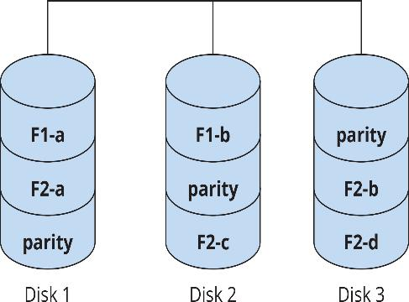
Protecting Data with Fault Tolerance (5 of 6)
Figure 12-30 RAID 5: stripe set with parity

Slide 55
Protecting Data with Fault Tolerance (6 of 6)
Server Clustering
A server cluster is made up of two or more servers that are interconnected and appear as a single unit
Two common types of clustering:
A failover cluster involves two or more servers sharing a high-speed link used to synchronize data. One server is the primary and others are standby. In the event the primary fails, a standby server takes its place
A load-balancing cluster consists of two or more servers that appear as a single unit to users. All servers in the cluster operate and share the load
youtube.com/watch?v=3Lis4w4_bBc

Slide 56
Knowledge Check Activity 12-2
Which RAID level requires a minimum of three disks and provides fault tolerance if one disk fails?
a. RAID 0
b. RAID 1
c. RAID 1+0
d. RAID 5

Slide 57
Knowledge Check Activity 12-2: Answer
Which RAID level requires a minimum of three disks and provides fault tolerance if one disk fails?
Answer: d. RAID 5
Explanation: Disk striping with parity requires a minimum of three disks but is more space efficient than RAID 1. RAID 5 works by spreading data across multiple disks and using one disk in each write operation to store parity information. Parity information is generated by a mathematical calculation on data being written, so if one of the disks fails, this information can be used to re-create lost data from the failed disk.

Slide 58
Self Assessment
Describe some of the Windows Default Domain Groups and the rights that each group has.
Compare the different RAID options that provide fault tolerance. Which type of RAID does not offer fault tolerance but enhances disk performance?

Slide 59
Summary
Now that the lesson has ended, you should be able to:
Manage user and group accounts
Administer permissions on storage volumes
Work with shared files and printers
Monitor a system’s performance and reliability
Describe fault-tolerance and backup solutions

